Slide 1
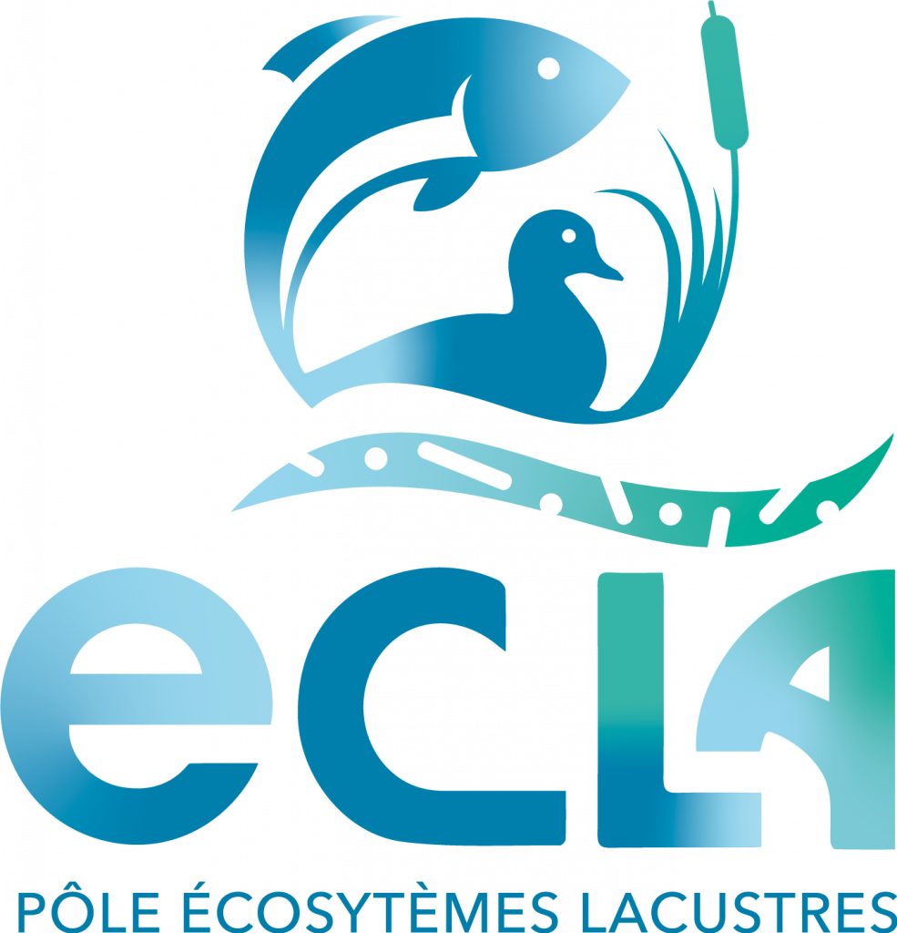

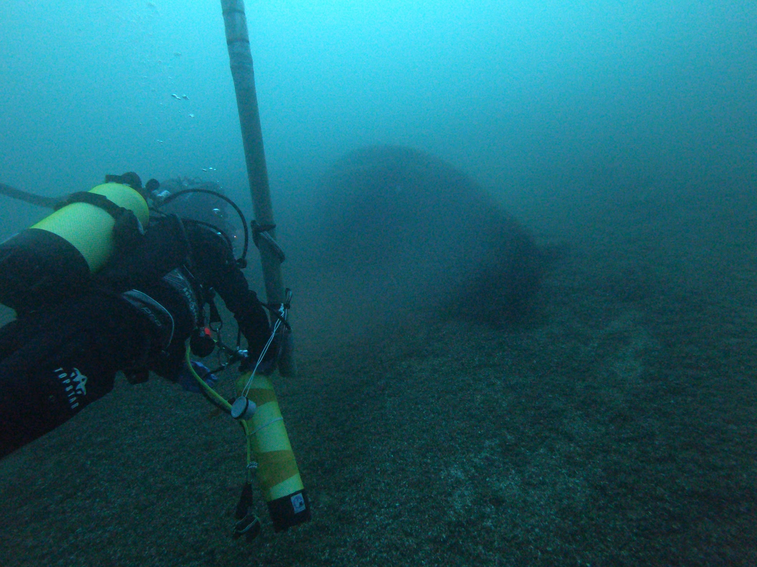
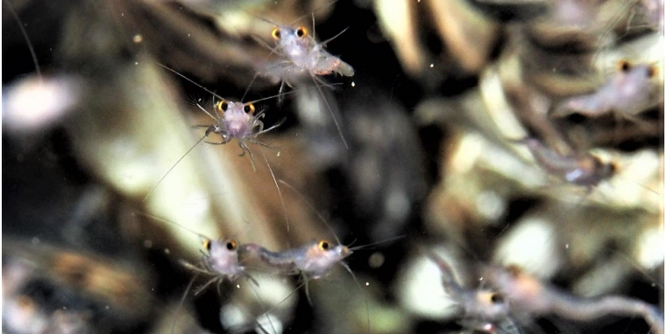
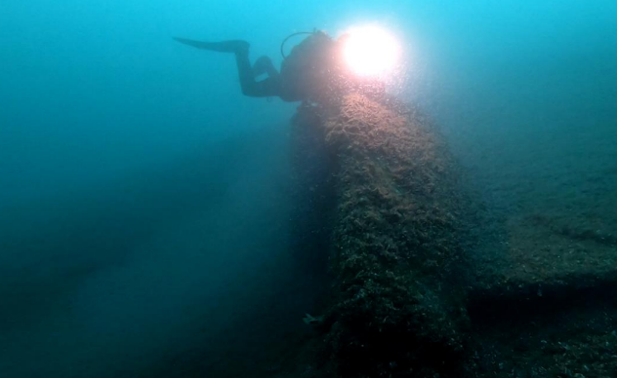


Diving monitoring and divers are precious to follow the invasive shrimp
Hemimysis anomala in lakes
Thonon-les-Bains
JACQUET Stéphan, GRIMOND Jonathan, FROSSARD Victor
stephan.jacquet@inrae.fr
ECSD
April 2021

Slide 2
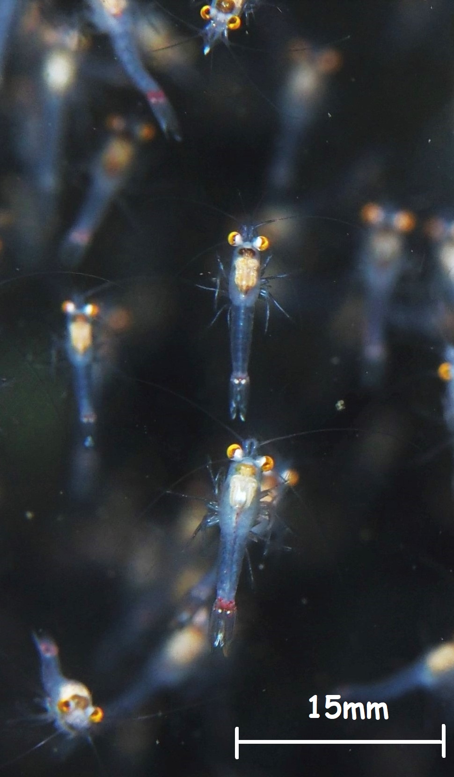
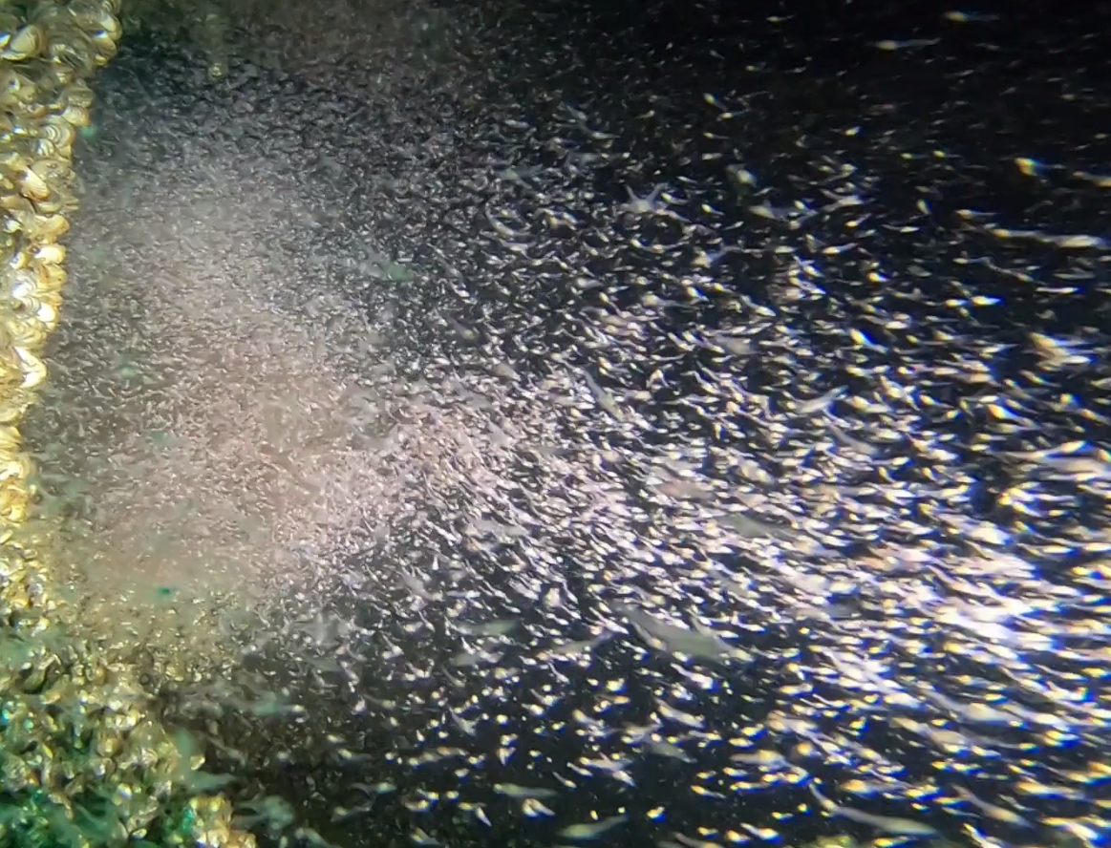
Scientific Context
Observation & Sampling
Results
Take home message
Context
The blood-red shrimp (Hemimysis anomala) is a small Mysidae (15 mm maximum in size) native from the Ponto-Caspian region
It recently settled in large peri-alpine lakes while it is paradoxically considered "endangered" in its original area
Many studies have already reported this invasion, but only a few using diving and
many aspects of the ecology of the species remain largely unknown
Swarm of H. anomala found
in Lake Geneva (S Jacquet)
Macrophotography (M Vassart)
Objectives of the MYSILAC project: Highlight in different diving sites of Lake Geneva the volume of water occupied by swarms, preferential habitats and the adult/juvenile proportion obtained using scientific and recreational divers

Slide 3
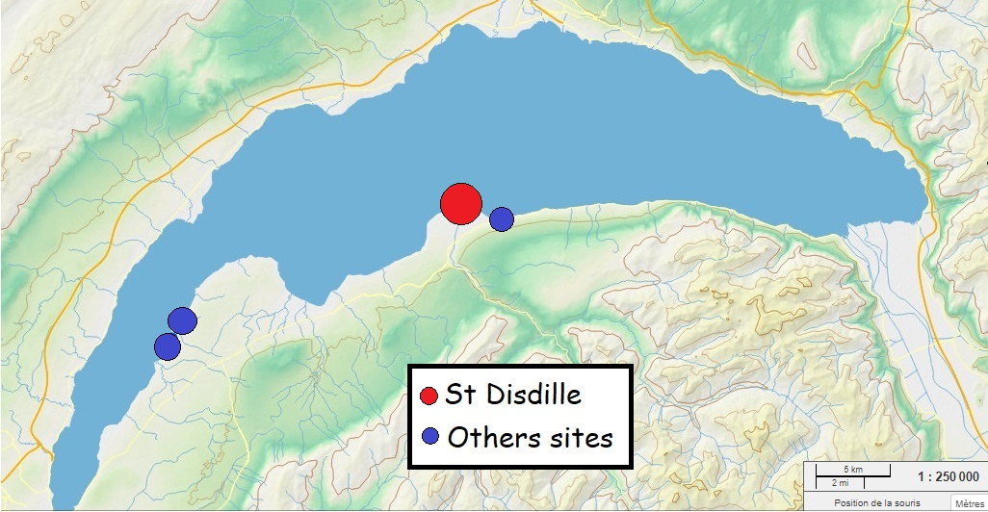
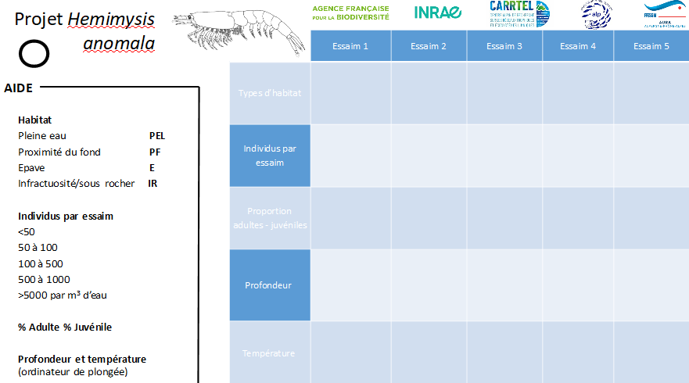
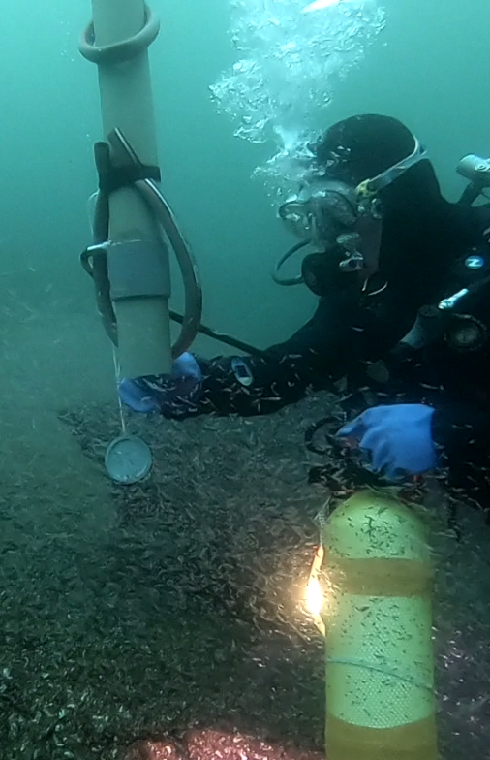
Scientific Context
Observation & Sampling
Results
Take home message
Context
SWITZERLAND
3 diving spots for participative science monitoring (France and Switzerland)
1 reference site for scientific divers (Saint-Disdille, Thonon-les-Bains, France)
FRANCE
Map of Lake Geneva
Habitat
Depth
Temperature
Estimation of number of individuals
Estimation of occupied volume
% adult vs juveniles
+ Design of a dedicated “shrimp sampler”
Submersible pad distributed to divers

Slide 4
Scientific Context
Observation & Sampling
Results
Take home message
Context
Spatial variation of habitat between Winter and Summer
Swarms in the water column only during winter
Preference for « safe » habitats
(rocks, tubes, wrecks)
Lack of predator during winter !
Preference for cold temperature ?
Seasonality between the % of adults vs juveniles

Slide 5
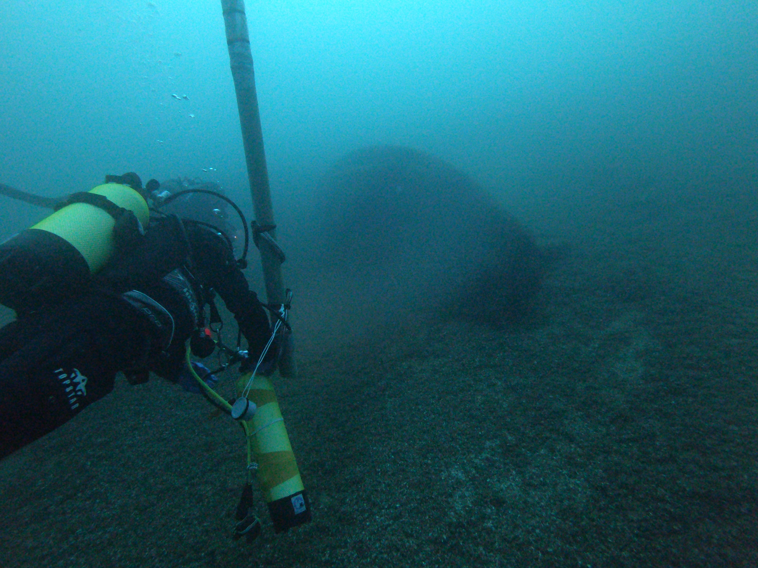

Scientific Context
Observation & Sampling
Results
Take Home message
Context
Diving allows for a detailed and unprecedented observation of the ecology of this invasive species in Lake Geneva
This strategy could be extended to a larger proportion of recreational divers (who are fond of participative sciences) and by extension to a larger number of diving sites
In 2021, we will try to assess the role of the shrimp in the lake food web through the analysis of collected animals using molecular and isotopic methods
To be continued…
https://youtu.be/ASdvzyUiJKI

